Slide 1
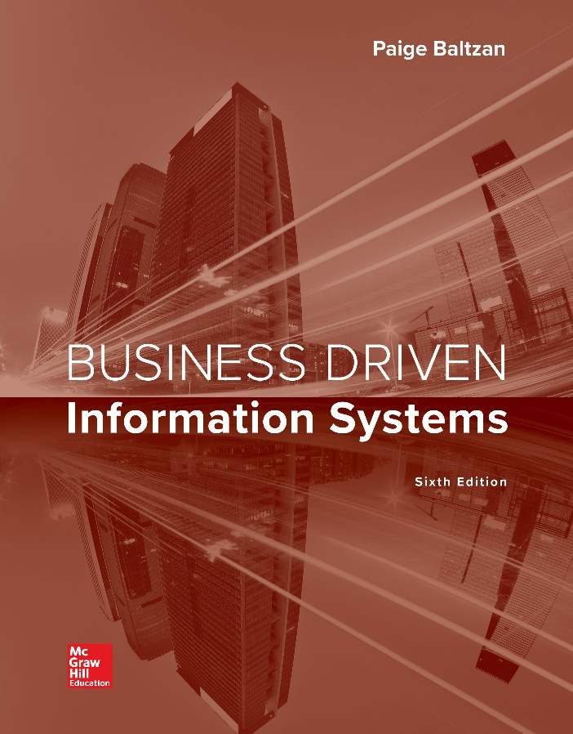
CHAPTER TWO
Decisions and Processes
Value Driven Business
Notes:
Decision making and problem solving encompass large-scale, opportunity-oriented, strategically-focused solutions
Organizations today can no longer use a “cook book” approach to decision making
This chapter focuses on technology to help make decisions, solve problems, and find new innovative opportunities
Decision support systems
Executive information systems
Artificial intelligence (AI)
Business processes
Business process mapping and modeling
Business process reengineering

Slide 2
Decision making and problem solving encompass large-scale, opportunity-oriented, strategically-focused solutions
Organizations today can no longer use a “cook book” approach to decision making
This chapter focuses on technology to help make decisions, solve problems, and find new innovative opportunities
Decision support systems
Executive information systems
Artificial intelligence (AI)
Business processes
Business process mapping and modeling
Business process reengineering

Slide 3
Chapter Two Overview
SECTION 2.1 – Decision Support Systems
Making Organizational Business Decisions
Measuring Organizational Business Decisions
Using MIS to Make Business Decisions
Using AI to Make Business Decisions
SECTION 2.2 – Business Processes
Managing Business Processes
Using MIS to Improve Business Processes

Slide 4
Section 2.1
DECISION SUPPORT SYSTEMS
Notes:
CLASSROOM OPENER
GREAT BUSINESS DECISIONS – Richard Sears Decides to Sell Products Through a Catalog
Sears Roebuck changed the shape of an entire industry by being lucky enough to discover a huge untapped market that lay waiting to be discovered. In the 1880s about 65 percent of the population (58 million) lived in the rural areas. Richard Sears lived in North Redwood, Minnesota, where he was an agent at the Minneapolis and St. Louis railway station. Sears began trading products such as lumber, coal, and watches, when the trains would pass through. Sears moved to Chicago in 1893 and partnered with Alvah C. Roebuck, and the Sears & Roebuck company was born. The company first published a 32 page catalog selling watches and jewelry. By 1895, the catalog was 532 pages long and included everything from fishing tackle to glassware. In 1893, sales reached $400,000 and by 1895 sales topped $750,000.
Sears invented many new marketing campaigns and concepts that are still in use today, including a series of rewards (or loyalty programs) for customers who passed copies of the catalog on to friends and relatives. Sears was one of the first companies to recognize the importance of building strong customer relationships. Sears’ loyalty program gave each customer 24 copies of the catalog to distribute, and the customer would generate points each time an order was placed from one of the catalogs by a new customer. The Sears catalog became a marketing classic. It brought the world to the isolated farms and was a feast for the new consumers. The entire world was available through the Sears catalog, and it could be delivered to the remotest of doorsteps.

Slide 5
GREAT BUSINESS DECISIONS – Richard Sears Decides to Sell Products Through a Catalog
Sears Roebuck幸運地發現了一個巨大未開發市場，從而改變了整個行業的形態。
在1880年代，大約65％的人口（5800萬）居住在農村地區。 Richard Sears居住在明尼蘇達州的North Redwood，是Minneapolis和St. Louis火車站的經理人。 當火車通過時，Sears開始交易木材，煤炭和手錶等產品。 Sears於1893年移居芝加哥，並與Roebuck合夥成立了Sears＆Roebuck公司。 該公司首先發行32頁的商品目錄，銷售鐘錶和珠寶。 到1895年，目錄已達532頁，涵蓋了從漁具到玻璃器皿的所有內容。 1893年，銷售額達到40萬美元，到1895年，銷售額突破了75萬美元。
Sears發明了許多仍在使用的新營銷活動和概念，包括對將目錄傳遞給親朋好友顧客的一系列獎勵（忠誠度計劃）。 西爾斯公司是最早認識到建立牢固的客戶關係的重要性的公司之一。 西爾斯的忠誠度計劃為每位客戶提供了24份產品目錄，以供分發，每當新客戶從其中一個產品目錄下訂單時，該客戶都會產生積分。 西爾斯目錄成為營銷典型。 它把世界帶到了偏僻的農場，是新消費者的盛宴。 整個世界都可以通過Sears目錄獲得，並且可以交付到最遙遠的門階。從1925年開始,西爾斯公司開始進入百貨商店的經營，曾是世界500強企業，2018聲請破產

Slide 6
Learning Outcomes 1 of 2
2.1 Explain the importance of decision making for managers at each of the three primary organization levels along with the associated decision characteristics.
2.2 Define critical success factors (CSFs) and key performance indicators (KPIs), and explain how managers use them to measure the success of MIS projects.
2.3 Classify the different operational, managerial, and strategic support systems, and explain how managers can use them to make decisions & gain competitive advantage.
2.4 Describe artificial intelligence and identify its five main types.

Slide 7
Making Organizational Business Decisions
Managerial decision-making challenges
Analyze large amounts of information
Apply sophisticated analysis techniques
Make decisions quickly
What is the value of information? how the information is used
Why two people looking at the exact same pieces of information could extract completely different value from the information?
Reasons for growth of decision-making information systems
People need to analyze large amounts of information—
People must make decisions quickly—
People must apply sophisticated analysis techniques, such as modeling and forecasting, to make good decisions—
Notes:
What is the value of information?
The answer to this important question varies depending on how the information is used
Ask your students why two people looking at the exact same pieces of information could extract completely different value from the information
Ans: One way that people can extract different value from similar information is by the information technology tools they use to analyze the information
Also, people’s personal experience and expertise will determine how they view and analyze information
Reasons for growth of decision-making information systems
People need to analyze large amounts of information—Improvements in technology itself, innovations in communication, and globalization have resulted in a dramatic increase in the alternatives and dimensions people need to consider when making a decision or appraising an opportunity.
People must make decisions quickly—Time is of the essence and people simply do not have time to sift through all the information manually.
People must apply sophisticated analysis techniques, such as modeling and forecasting, to make good decisions—Information systems substantially reduce the time required to perform these sophisticated analysis techniques.

Slide 8
The Decision-Making Process
The six-step decision-making process
Problem identification
Data collection
Solution generation
Solution test
Solution selection
Solution implementation
Notes:
In-class critical thinking activity.
Applying this process to a real life type scenario/business – Use a sample business to answer questions and follow the 6-step process (Each student is the CEO of one of these company’s struggling with some processes in the business): examples; a coffee shop, a wholesale warehouse, an accounting firm, a gas & oil company, etc.
Problem Identification
What are the key problems affecting the business?
What are the customer saying about the service and the product?
What is the root cause of any decline in revenue, or production time?
Data Collection
Why are certain processes falling short?
And what are the immediate steps the company can take to adjust the current processes to improve them?
Who are you listening to, are they actual or rumor complaints?
What departments are struggling?
Solution Generation
What are some of the solutions you have for improvement?
What are some of the solutions your management team has?
How will you go about collecting all the best solutions?
Solution Test
Are these solutions long-term or short-term solutions?
What are some of the cost factors associated with the solutions?
Does your team like the solution or are they going to sabotage it because they are unhappy with the decision made?
Solution Selection
As the executive leader of the company are you comfortable with the decision you made?
How are you going to take a strong lead on this decision without alienating yourself?
Solution Implementation
Evaluate and track how the solution is working?
Is it achieving the results that you wanted?
Is the results are poor, what steps do you need to take to adjust?
As the leader for the company, how will you appropriately change the solution direction without upsetting the environment or flow of the employees and production?

Slide 9
Problem Identification
What are the key problems affecting the business?
What are the customer saying about the service and the product?
What is the root cause of any decline in revenue, or production time?
Data Collection
Why are certain processes falling short?達不到
And what are the immediate steps the company can take to adjust the current processes to improve them?
Who are you listening to, are they actual or rumor complaints?
What departments are struggling?苦苦掙扎
Solution Generation
What are some of the solutions you have for improvement?
What are some of the solutions your management team has?
How will you go about collecting all the best solutions?

Slide 10
Solution Test
Are these solutions long-term or short-term solutions?
What are some of the cost factors associated with the solutions?
Does your team like the solution or are they going to sabotage it because they are unhappy with the decision made?破壞
Solution Selection
As the executive leader of the company are you comfortable with the decision you made?
How are you going to take a strong lead on this decision without alienating yourself?疏远
Solution Implementation
Evaluate and track how the solution is working?
Is it achieving the results that you wanted?
Is the results are poor, what steps do you need to take to adjust?
As the leader for the company, how will you appropriately change the solution direction without upsetting the environment or flow of the employees and production?推翻

Slide 11
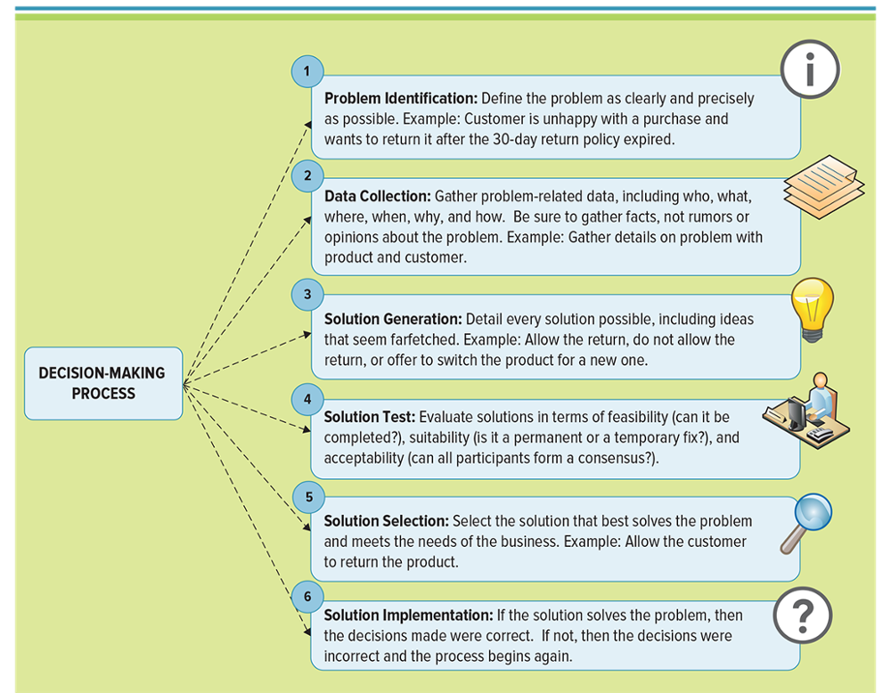
Figure 2.4 The Six-Step Decision-Making Process
farfetch牵强

Slide 12
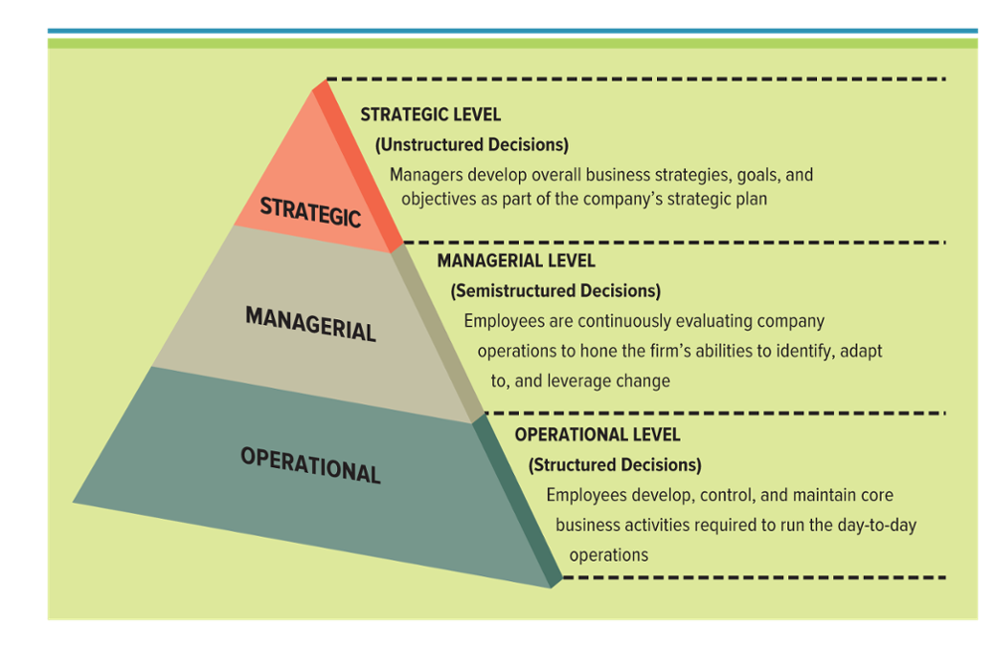
Figure 2.5 Common Company Structure
Decision-making and problem-solving occur at each level in an organization
Jump to long image description
Notes:
Making Business Decisions - Understanding the way people makes decisions is critical to embrace. The way people make decisions is going to affect your business and the culture that is created there.
Ask your students to differentiate between strategic, managerial, and operational with an example such as Target
Strategic, CIO, CFO, CEO
Managerial, Regional district manager, Store manager
Operational, cashier, customer service representative, inventory stocker, janitor守卫

Slide 13
Decision-Making Essentials 1 of 3基本原则
Operational decision making - Employees develop, control, and maintain core business activities required to run the day-to-day operations
Structured decisions - Situations where established processes offer potential solutions
Operational Decision Making
Employee Type: lower management, analysts, staff
Focus: Internal, functional
Time Frame: Short term, day-to-day operations
Decision Types: Structured, recurring, repetitive
MIS Type: Information
Metrics: Key performance indicators focus on efficiency
Examples:
How many employees are out sick?
How many products need to be made today?
What are next week’s production requirements?
How much inventory is in the warehouse?
How many problems occurred when running payroll?
Which employees are on vacation?
System:
Training & development
Accounts payable & receivable
Employee record keeping
Scheduling
Order processing
Order tracking
Notes:
Operational Decision Making
Employee Type: lower management, analysts, staff
Focus: Internal, functional
Time Frame: Short term, day-to-day operations
Decision Types: Structured, recurring, repetitive
MIS Type: Information
Metrics: Key performance indicators focus on efficiency
Examples:
How many employees are out sick?
How many products need to be made today?
What are next week’s production requirements?
How much inventory is in the warehouse?
How many problems occurred when running payroll?
Which employees are on vacation?
What are some examples of types of systems or activities at this level?
Payroll
Training & development
Accounts payable & receivable
Employee record keeping
Scheduling
Order processing
Order tracking

Slide 14
Decision-Making Essentials 2 of 3
Managerial decision making – Employees evaluate company operations to identify, adapt to, and leverage change
Semistructured decisions – Occur in situations in which a few established processes help to evaluate potential solutions, but not enough to lead to a definite recommended decision
Managerial Decision Making
Employee Type: Middle mgmt., managers, directors
Focus: Internal, cross-functional
Time Frame: Short term, daily, monthly, yearly
Decision Types: Semistructured, adhoc, reporting
MIS Type: Business Intelligence
Metrics: KPIs focusing on efficiency, and CSFs
focusing on effectiveness
Examples:
Who are our best customers by region, by sales representatives, by product?
What are the sales forecasts for next month? How do they compare to actual sales for last year?
What was the difference between expected sales and actual sales for each month?
What was the impact of last month’s marketing campaign on sales?
What types of ad hoc or unplanned reports might the company require next month?
System: Sales management, Pricing & profitability, Contract analysis, Production costs, Sales analysis by region, Inventory, Audits
Notes:
Managerial Decision Making
Employee Type: Middle mgmt., managers, directors
Focus: Internal, cross-functional
Time Frame: Short term, daily, monthly, yearly
Decision Types: Semistructured, adhoc, reporting
MIS Type: Business Intelligence
Metrics: KPIs focusing on efficiency, and CSFs focusing on effectiveness
Examples:
Who are our best customers by region, by sales representatives, by product?
What are the sales forecasts for next month? How do they compare to actual sales for last year?
What was the difference between expected sales and actual sales for each month?
What was the impact of last month’s marketing campaign on sales?
What types of ad hoc or unplanned reports might the company require next month?
What are some examples of types of systems or activities at this level?
Sales management
Pricing & profitability
Contract analysis
Production costs
Sales analysis by region
Inventory
Audits

Slide 15
Decision-Making Essentials 3 of 3
Strategic decision making – Managers develop overall strategies, goals, and objectives
Unstructured decisions – Occurs in situations in which no procedures or rules exist to guide decision makers toward the correct choice
Strategic Decision Making
Employee Type: Senior management, presidents
Focus: external, industry, cross company
Time Frame: Long term, yearly, multi-year
Decision Types: Unstructured, nonrecurring, one time
MIS Type: Knowledge
Metrics: CSFs focusing on effectiveness
Examples:
How will changes in employment levels over the next three years impact the company?
What industry trends are worth analyzing?
What new products and new markets does the company need to create competitive advantages?
How will a recession over the next years impact business?
What measures will the company need to prepare for due to new tax laws?
System: Sales trend forecasting, Budget forecasting, Profit planning, 5-year forecast planning
Notes:
Strategic Decision Making
Employee Type: Senior management, presidents
Focus: external, industry, cross company
Time Frame: Long term, yearly, multi-year
Decision Types: Unstructured, nonrecurring, one time
MIS Type: Knowledge
Metrics: CSFs focusing on effectiveness
Examples:
How will changes in employment levels over the next three years impact the company?
What industry trends are worth analyzing?
What new products and new markets does the company need to create competitive advantages?
How will a recession over the next years impact business?
What measures will the company need to prepare for due to new tax laws?
What are some examples of types of systems or activities at this level?
Sales trend forecasting
Budget forecasting
Profit planning
5-year forecast planning

Slide 16
Measuring Organizational Business Decisions 1 of 4
Project – A temporary activity a company undertakes to create a unique product, service, or result
Metrics – Measurements that evaluate results to determine whether a project is meeting its goals
How to define metrics to evaluate a projects success?
Buying a new car
Purchasing a home
Renting an apartment
Buying a new office building
Buying employee health insurance
Notes:
Ask your students why they would want to define metrics to evaluate a projects success?
What types of metrics would they apply to the following situations? How would the metrics help them determine if their decision was successful?
Buying a new car
Purchasing a home
Renting an apartment
Buying a new office building
Buying employee health insurance

Slide 17
Measuring Organizational Business Decisions 2 of 4
Critical success factors (CSFs) – The crucial steps companies make to perform to achieve their goals and objectives and implement strategies
Create high-quality products
Retain competitive advantages
Reduce product costs
Increase customer satisfaction
Hire and retain the best professionals
What categories would students list if they were writing their own personal CSFs?
Learning, Earn a Degree, Practicing Healthy Habits, Building strong friendships
Notes:
Ask your students what categories would they list if they were writing their own personal CSFs?
Potential answers include:
Engage in Continuous Learning, Earn a Degree
Exercising and Practicing Healthy Habits
Building strong relationships and friendships

Slide 18
Measuring Organizational Business Decisions 3 of 4
Key performance indicators (KPIs) – The quantifiable metrics a company uses to evaluate progress toward critical success factors
Turnover rates of employees
Number of product returns
Number of new customers
Average customer spending
Notes:
Key points to understand about CSFs and KPIs:
CSFs = are elements crucial for a business strategy’s success and one CSF can have many KPIs
KPIs = measure the progress of the CSFs with quantifiable measurements can focus on external and internal measurements
RESOURCE FOR CLASSROOM ACTIVITY
http://www.kpilibrary.com - KPI Library
This is a KPI library or aggregator for finding KPIs in many industry’s. Over 240,000 professionals use this library to research, and share and compare KPI strategies with other executives all over the world

Slide 19
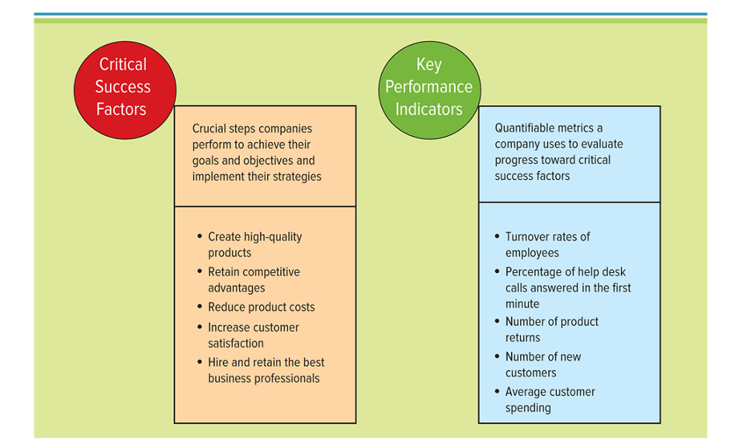
Figure 2.7 CSF and KPI Metrics
Jump to long image description

Slide 20
CSF & KPI
Example 1: A restaurant
Goal: Increase profit by 5% by January next year by increasing throughput by 10% in lunch and dinner trade without reducing our gross margins.
Example 2: Whitegoods manufacturer
Goal: To increase the operating profit of a washing machine manufacturer by 5% within two years.
CSF | KPI | Target
Market share | % of business within a 5km radius | 10%
Customer satisfaction | % of customers who are satisfied | 95%
Meal quality | % of meals returned because of poor quality | 2%
CSF | KPI | Target
High product quality | Number of warranty claims per 100 units | 3
High process yields | % rolled throughput yield | 95%
Low production costs | Average variable costs | <$350
Market share | % of the market | 15%

Slide 21
Measuring Organizational Business Decisions 4 of 4
External KPI
Market share – The portion of the market that a firm captures (external)
Internal KPI
Return on investment (ROI) – Indicates the earning power of a project
Notes:
Measuring market share and especially ROI, are getting harder and harder to track when you add to the equation social media and online marketing. There are debates on both sides of how to measure these effectively, but truly only time will tell the actual impact of all these new technologies have on the business environment.
CLASSROOM EXERCISE
Ask your students these questions. Help them understand the bigger picture with running a business and growing market share:
Who are your target customers?
What market is your business? (“The biggest mistake entrepreneurs make is to first build a product and then go looking for a market,” says Alan Hall, founder of Grow Utah Ventures. “It’s completely backwards.”)
Do you have realistic goals to launch your product?
What are your competitors up to? Stay connected to the pulse of the market and what your competitors are doing

Slide 22
Efficiency and Effectiveness Metrics
Efficiency MIS metrics – Measure the performance of MIS itself, such as throughput, transaction speed, and system availability Doing things right- getting the most from each resource (Peter Drucker)
Effectiveness MIS metrics – Measures the impact MIS has on business processes and activities, including customer satisfaction and customer conversation rates
Doing the right things– setting the right goals and objectives and ensuring they are accomplished
Notes:
Efficiency MIS Metrics
Focuses on the extent to which a firm is using its resources in an optimal way. Doing things right – getting the most from each resource (Peter Drucker)
Effectiveness MIS Metrics
Focuses on how well a firm is achieving its goals and objectives Doing the right things – setting the right goals and objectives and ensuring they are accomplished
CLASSROOM APPLICATIONS
(Peter Drucker) Share a great PPT on how Drucker would tackle “Enterprise 2.0 Strategies = http://www.slideshare.net/fidelman/what-if-peter-drucker-taught-enterprise-20
What is the most optimal position to operate in relation to these two concepts? When both are high
What tools can you utilize to measure both?
Break into groups, each with a business and a product and the challenges facing the company – now come up with ways to efficiently and effectively overcome these challenges. Use the metrics or tools talked about below:
Common types of efficiency and effectiveness metrics:
EFFICIENCY
Throughput: the amount of information that can travel through a system
Transaction speed: the amount of time a system takes to perform a transaction
System availability: the number of hours a system is available
Information accuracy: How often a system generates the correct results when doing the same transaction many times
Response time: how long it takes to respond to user interactions, for example a mouse click
EFFECTIVENESS
Usability: the ease with which people perform transactions or find info
Customer satisfaction: measured by satisfaction surveys, how many retained, and increase in revenue per customer
Conversion rates: how many ‘touches’ it takes to convert a first time user to become a customer and purchase the product
Financial: ROI, cost-benefit analysis, break-even analysis

Slide 23
EFFICIENCY
Throughput: the amount of information that can travel through a system
Transaction speed: the amount of time a system takes to perform a transaction
System availability: the number of hours a system is available
Information accuracy: How often a system generates the correct results when doing the same transaction many times
Response time: how long it takes to respond to user interactions, for example a mouse click
EFFECTIVENESS
Usability: the ease with which people perform transactions or find info
Customer satisfaction: measured by satisfaction surveys, how many retained, and increase in revenue per customer
Conversion rates: how many ‘touches’ it takes to convert a first time user to become a customer and purchase the product
Financial: ROI, cost-benefit analysis, break-even analysis

Slide 24
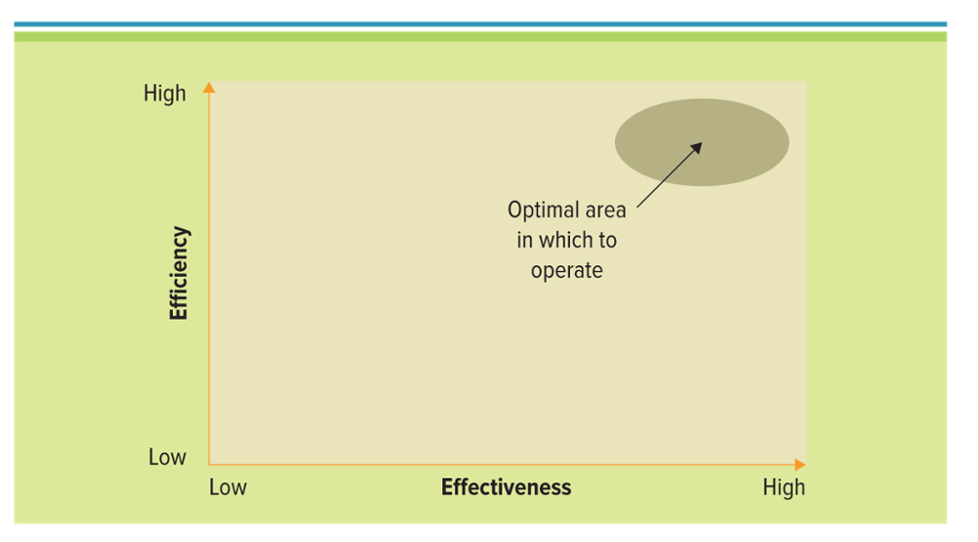
Figure 2.10 The Interrelationships between Efficiency and Effectiveness
Ideal operation occurs in the upper right corner
Notes:
Ideally, a firm wants to operate in the upper right-hand corner of the graph, realizing both significant increases in efficiency and effectiveness
Operating in the upper left-hand corner (minimal effectiveness with increased efficiency) or the lower right-hand corner (significant effectiveness with minimal efficiency) may be in line with an organizations’ particular strategy
In general, operating in the lower left-hand corner (minimal efficiency and minimal effectiveness) is not ideal for the operation of any organization

Slide 25
The Interrelationship Between Efficiency and Effectiveness Metrics
Benchmark – Baseline values the system seeks to attain
Benchmarking – A process of continuously measuring system results, comparing those results to optimal system performance (benchmark values), and identifying steps and procedures to improve system performance
If a system held a benchmark for response time of 15 seconds, the manager would want to ensure response times did not deviate from this point, including increases or decreases
Notes:
Benchmarks help assess how an MIS project performs over time
If a system held a benchmark for response time of 15 seconds, the manager would want to ensure response times did not deviate from this point, including increases or decreases.

Slide 26
Using MIS to Make Business Decisions
Model – A simplified representation or abstraction of reality
Models help managers to
Calculate risks
Understand uncertainty
Change variables
Manipulate time to make decisions
DSS, EIS, or AI system to model reality
Excel is a DSS. You can use many of the tools found in Excel, such as Scenario Manager, Goal Seek, Solver, and Pivot Tables to support DSS activities
Notes:
Models can calculate risks, understand uncertainty, change variables, and manipulate time
Ask your students if any of them have ever worked with a DSS, EIS, or AI system? What types of models are they using today at their jobs or in their personal lives?
Ans: Many of your students have worked with a DSS and might not know it. Excel is a DSS. You can use many of the tools found in Excel, such as Scenario Manager, Goal Seek, Solver, and Pivot Tables to support DSS activities

Slide 27
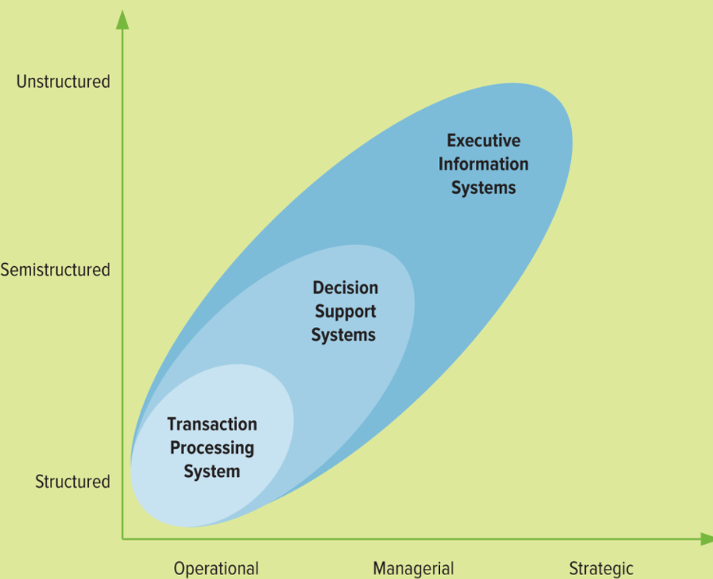
Figure 2.11 Primary Types of MIS Systems for Decision Making
Jump to long image description
Notes:
Decision support system (DSS): models information to support managers and business professionals during the decision-making process
Executive information system (EIS): a specialized DSS that supports senior level executives within the organization
Artificial intelligence (AI): simulates human intelligence such as the ability to reason and learn

Slide 28
Operational Support Systems
Transaction processing system (TPS) – Basic business system that serves the operational level and assists in making structured decisions
Online transaction processing (OLTP) - Capturing of transaction and event information using technology to process, store, and update
Source document – The original transaction record
What types of TPS are used at your college?
Payroll system (Tracking hourly employees)
Accounts Payable system
Accounts Receivable system
Course registration system
Human resources systems (tracking vacation, sick days)
Notes:
Transactional Information: encompasses all of the information contained within a single business process or unit of work, and its primary purpose is to support the performing of daily operational or structured decisions.
Transaction processing system (TPS): basic business system that serves the operational level and assists in making structured decisions.
Online transaction processing (OLTP): capturing of transaction and event information using technology to process, store, and update.
Source Documents: Using systems thinking, the inputs for a TPS or the original transaction record.
Analysts typically use TPS to perform their daily tasks
What types of TPS are used at your college?
Payroll system (Tracking hourly employees)
Accounts Payable system
Accounts Receivable system
Course registration system
Human resources systems (tracking vacation, sick days)

Slide 29
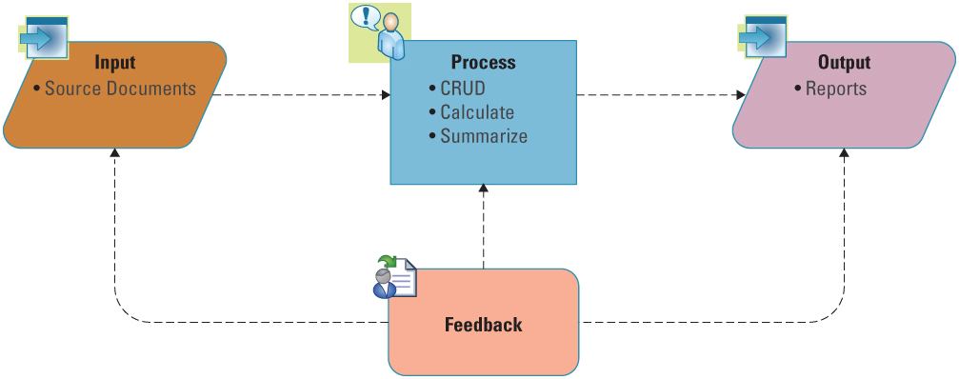
Figure 2.12 Systems Thinking Example of a TPS
Create, read, update, and delete (CRUD) are the common processes associated with a TPS
Feedback is critical and ensuring the appropriate metrics are associated is a key goal for many managers
CRUD Create, read, update, and delete
Notes:
Create, read, update, and delete (CRUD) are the common processes associated with a TPS
Common inputs are source documents and outputs are reports
Ask your students why would a manager want to view a TPS in terms of systems thinking?
Systems thinking provides a holistic view of a system or an overview of a system
Viewing a system from end-to-end will provide a manager with a better view of opportunities and challenges associated with inputs, processes, and outputs
Feedback is critical and ensuring the appropriate metrics are associated is a key goal for many managers

Slide 30
Managerial Support Systems 1 of 2
Online analytical processing (OLAP) – Manipulation of information to create business intelligence in support of strategic decision making
Decision support system (DSS) – Models information to support managers and business professionals during the decision-making process
Notes:
Analytical Information: Encompasses all organizational information, and its primary purpose is to support the performing of managerial analysis or semistructured decisions
Online analytical processing (OLAP): Manipulation of information to create business intelligence in support of strategic decision making
Decision support system (DSS): Models information to support managers and business professionals during the decision-making process
Analysts typically use TPS to perform their daily tasks – Ask your students what types of TPS are used at your college?
Payroll system (Tracking hourly employees)
Accounts Payable system
Accounts Receivable system
Course registration system
Human resources systems (tracking vacation, sick days)

Slide 31
Managerial Support Systems 2 of 2
Four quantitative models used by DSSs include
What-if analysis
Sensitivity analysis
Goal-seeking analysis
Optimization analysis
What-if analysis: checks the impact of a change in an assumption on the proposed solution
Sensitivity analysis: the study of the impact that changes in one (or more) parts of the model have on other parts of the model Goal-seeking analysis: finds the inputs necessary to achieve a goal such as a desired level of output
Optimization analysis: An extension of goal-seeking analysis, finds the optimum value for a target variable by repeatedly changing other variables, subject to specified constraints.
Notes:
What-if analysis: checks the impact of a change in an assumption on the proposed solution
Sensitivity analysis: the study of the impact that changes in one (or more) parts of the model have on other parts of the model Goal-seeking analysis: finds the inputs necessary to achieve a goal such as a desired level of output
Optimization analysis: An extension of goal-seeking analysis, finds the optimum value for a target variable by repeatedly changing other variables, subject to specified constraints.
In a DSS, data is first queried and collected from the knowledge database
Results from the query are then checked and analyzed against decision models
Once checked against the decision models, the results are then generated for review to find a “best” solution for the situation
One national insurance company uses DSSs to analyze the amount of risk the company is undertaking when it insures drivers who have a history of driving under the influence of alcohol. The DSS discovered that only 3 percent of married male homeowners in their forties received more than one DUI. The company decided to lower rates for customers falling into this category, which increased its revenue while mitigating its risk.

Slide 32
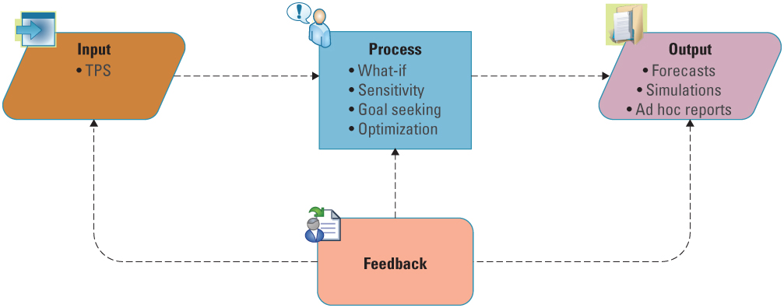
Figure 2.14 Systems Thinking Example of a DSS
Jump to long image description
Notes:
CLASSROOM EXERCISE
DSSs All Around
Break your students into groups and ask them to compare sensitivity analysis, what-if analysis, and goal-seeking analysis and to provide a business example of when they would use each type?
Sensitivity analysis: studies the impact on a single change in a current model. For example, if we continually change the amount of inventory we carry, how low can our inventories go before issues start occurring in other parts of the supply chain? This would require changing the inventory level and watching the model to see “how sensitive” it is to inventory levels.
What-if analysis: determines the impact of change on an assumption or an input. For example, if the economic condition improves, how will it affect our sales?
Goal-seeking analysis: solves for a desired goal. For example, we want to improve revenues by 30 percent, how much does sales have to increase and costs have to decrease to meet this goal?

Slide 33
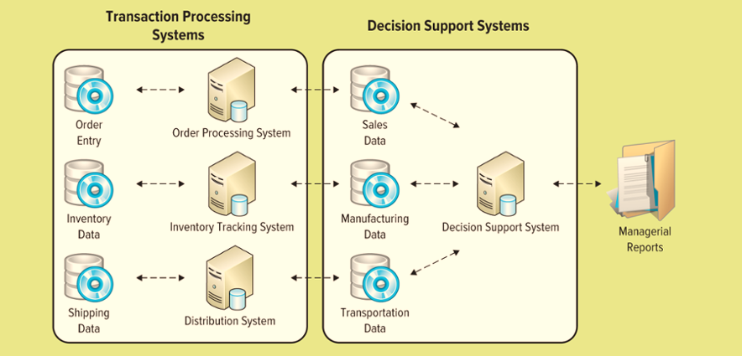
Figure 2.15 Interaction between TPS and DSS to Support Semistructured Decisions
Jump to long image description
Notes:
The TPS supplies transaction-based data to the DSS
The DSS summarizes and aggregates the information from the many different TPS systems, which assists managers in making informed decisions. Burlington Northern and Santa Fe Railroad (BNSF) regularly tests its railroad tracks
Each year hundreds of train derailments result from defective tracks
Using a DSS to schedule train track replacements helped BNSF decrease its rail-caused derailments by 33 percent

Slide 34
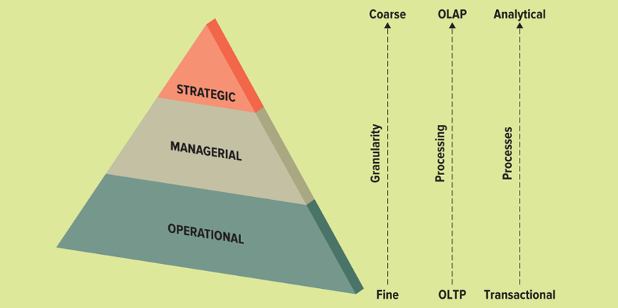
Figure 2.16 Information Levels throughout an Organization
Jump to long image description
Notes:
The structure of a typical organization is similar to a pyramid
Organizational activities occur at different levels of the pyramid
People in the organization have unique information needs and thus require various sets of IT tools (see Figure)
At the lower levels of the pyramid, people perform daily tasks such as processing transactions
Moving up through the organizational pyramid, people (typically managers) deal less with the details (“finer” information) and more with meaningful aggregations of information (“coarser” information) that help them make broader decisions for the organization
Granularity refers to the extent of detail in the information (means fine and detailed or “coarse” and abstract information)

Slide 35
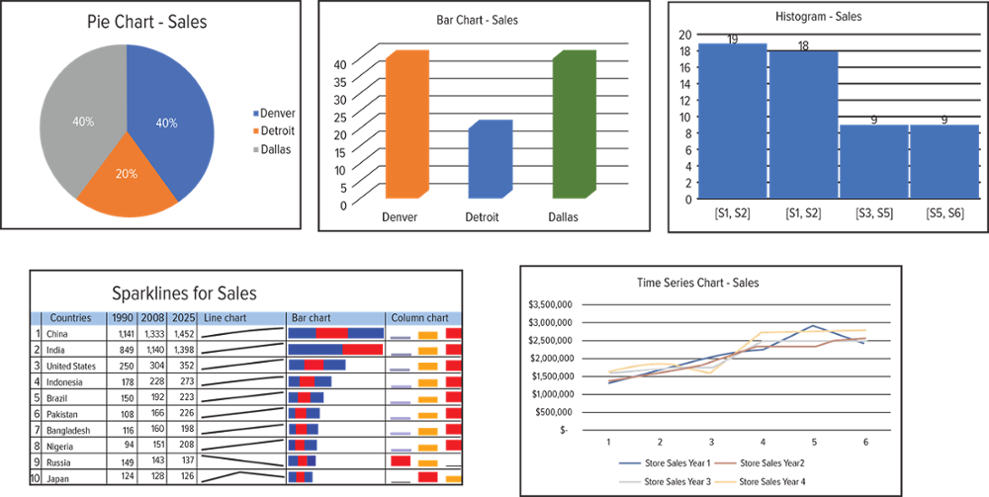
Figure 2.18 Visualization Chart Types
A sparkline is a small embedded line graph that illustrates a single trend. Sparklines are often used in reports, presentations, dashboards, and scoreboards. They do not include axes or labels; context comes from the related content.
Notes:
Ask your students for examples of data that might use each of the common elements of an infographic include the following:
A pie chart a type of graph in which a circle is divided into sectors that each represent a proportion of the whole.
A bar chart is a chart or graph that presents grouped data with rectangular bars with lengths proportional to the values that they represent.
A histogram is a graphical display of data using bars of different heights. It is similar to a bar chart, but a histogram groups numbers into ranges
A sparkline is a small embedded line graph that illustrates a single trend. Sparklines are often used in reports, presentations, dashboards, and scoreboards. They do not include axes or labels; context comes from the related content.
A time-series chart is a graphical representation showing change of a variable over time. Time-series charts are used for data that changes continuously, such as stock prices. They allow for a clear visual representation of a change in one variable over a set amount of time

Slide 36
Strategic Support Systems 1 of 2
Executive information system (EIS) – A specialized DSS that supports senior level executives within the organization
Granularity
Visualization
Digital dashboard
Granularity: Refers to the level of detail in the model or the decision-making process
Visualization: Produces graphical displays of patterns and complex relationships in large amounts of data
Digital dashboard: Tracks KPIs and CSFs by compiling information from multiple sources and tailoring it to meet user needs
Notes:
Executive information system (EIS): a specialized DSS that supports senior level executives within the organization
Granularity: Refers to the level of detail in the model or the decision-making process
Visualization: Produces graphical displays of patterns and complex relationships in large amounts of data
Digital dashboard: Tracks KPIs and CSFs by compiling information from multiple sources and tailoring it to meet user needs
As digital dashboards become easier to use, more executives can perform their own analysis without inundating IT personnel with queries and request for reports
Why, according to Nucleus Research, is there a direct correlation between use of digital dashboards and a company’s return on investment (ROI)?
Digital dashboards, whether basic or comprehensive, deliver results quickly
The quicker employees have information, the quicker they can respond to problems, threats, and opportunities
CLASSROOM EXERCISE
Hod Lipson Demonstrates Cool Little Robots
Hod Lipson demonstrates a few of his cool little robots, which have the ability to learn, understand themselves, and even self-replicate. At the root of this uncanny demo is a deep inquiry into the nature of how humans and living beings learn and evolve, and how we might harness these processes to make things that learn and evolve. Hod Lipson works at the intersection of engineering and biology, studying robots and the way they "behave" and evolve. His work has exciting implications for design and manufacturing and serves as a window to understand our own behavior and evolution.

Slide 37
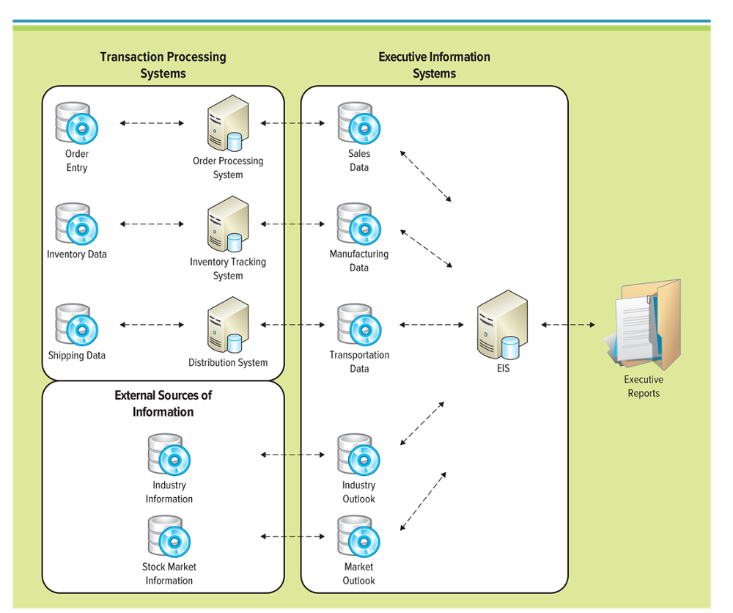
Figure 2.17 Interaction between a TPS and EIS
Jump to long image description
Notes:
Why would you need interaction between a TPS and EIS?
The EIS needs information from the TPS to help executives make decisions
Without knowing order information, inventory information, and shipping information from the TPSs, it would be very difficult for the CEO to make strategic decisions for the organization

Slide 38
Strategic Support Systems 2 of 2
Most EISs offering the following capabilities:
Consolidation
Drill-down
Slice-and-dice
Pivot
Consolidation: involves the aggregation of information and features simple roll-ups to complex groupings of interrelated information
Drill-down: enables users to get details, and details of details, of information
Slice-and-dice: looks at information from different perspectives
Pivot: Rotates data to display alternative presentations of the data
Notes:
Consolidation: involves the aggregation of information and features simple roll-ups to complex groupings of interrelated information
Drill-down: enables users to get details, and details of details, of information
Slice-and-dice: looks at information from different perspectives
Pivot: Rotates data to display alternative presentations of the data
Can you name a few different situations when you would use consolidation, drill-down, and slice-and-dice?
Consolidation would occur when grouping multiple store sales together to get a total for the company
Drill-down would occur when digging into the numbers on the balance sheet or income statement, such as revenues broken down into individual product revenues for each store during different dates and times
Slice-and-dice would occur when users begin looking at information with different dimensions, similar to the cubes of information

Slide 39
Using AI to Make Business Decisions 1 of 6
Artificial intelligence (AI) – Simulates human intelligence such as the ability to reason and learn
Intelligent system – Various commercial applications of artificial intelligence
1.在英格蘭的曼徹斯特機場，Hefner AI機器人清潔工可以提醒乘客安全和不吸煙規則，同時每天可以擦洗65,600平方英尺的地板。雷射掃描儀和超音波探測器可防止乘客發生碰撞。
2.殼牌石油公司的SmartPump可以在寒冷潮濕的冬天讓駕駛員駕駛汽車。它可以為1987年以後建造的任何汽車提供服務，這些汽車配備了一個特殊的氣帽和一個安裝在擋風玻璃上的轉發器，告訴機器人在哪裡插入加油泵。
3.松下的快遞機器人導航醫院走廊，提供患者檔案，X光片和醫療用品。
4.FireFighter AI Robot可以用水，泡沫，粉末或惰性氣體熄滅化工廠和核反應堆的火焰。機器人將操作員和火災設置間隔距離。
Notes:
At Manchester Airport in England, the Hefner AI Robot Cleaner alerts passengers to security and nonsmoking rules while it scrubs up to 65,600 square feet of floor per day. Laser scanners and ultrasonic detectors keep it from colliding with passengers.
Shell Oil’s SmartPump keeps drivers in their cars on cold, wet winter days. It can service any automobile built after 1987 that has been fitted with a special gas cap and a windshield-mounted transponder that tells the robot where to insert the pump.
Matsushita’s courier robot navigates hospital hallways, delivering patient files, X-ray films, and medical supplies.
The FireFighter AI Robot can extinguish flames at chemical plants and nuclear reactors with water, foam, powder, or inert gas. The robot puts distance between human operators and the fire.
AI systems increase the speed and consistency of decision making, solve problems with incomplete information, and resolve complicated issues that cannot be solved by conventional computing. There are many categories of AI systems; five of the most familiar are: (1) expert systems, (2) neural networks, (3) genetic algorithms, (4) intelligent agents, and (5) virtual reality

Slide 40
Using AI to Make Business Decisions 2 of 6
Machine learning - A type of artificial intelligence that enables computers to both understand concepts in the environment, and also to learn
Weak AI
Strong AI
Weak AI: Weak AI machines can still make their own decisions based on reasoning and past sets of data. Most of the AI systems in market today are weak AI.
Strong AI: Strong refers to the field of artificial intelligence that works toward providing brainlike powers to AI machines; in effect, it works to make machines as intelligent as the humans
Notes:
Weak AI: Weak AI machines can still make their own decisions based on reasoning and past sets of data. Most of the AI systems in market today are weak AI.
Strong AI: Strong refers to the field of artificial intelligence that works toward providing brainlike powers to AI machines; in effect, it works to make machines as intelligent as the humans.

Slide 41
Using AI to Make Business Decisions 3 of 6
Five most common categories of AI
Expert system – Computerized advisory programs that imitate the reasoning processes of experts in solving difficult problems
Machine vision – The ability of a computer to “see” by digitizing an image, processing the data it contains, and taking some kind of action
Notes:
Expert systems
Human expertise is transferred to the expert system, and users can access the expert system for specific advice
Most expert systems contain information from many human experts and can therefore perform a better analysis than any single human
Ask your students how expert systems could be used in the medical field
Machine vision sensitivity is the ability of a machine to see in dim light or to detect weak impulses at invisible wavelengths.
Machine vision resolution is the extent to which a machine can differentiate between objects. In general, the better the resolution, the more confined the field of vision

Slide 42
Using AI to Make Business Decisions 4 of 6
Five most common categories of AI continued
Neural Network – Attempts to emulate the way the human brain works
Fuzzy logic – A mathematical method of handling imprecise or subjective information
Deep learning – A process that employs specialized algorithms to model and study complex datasets; the method is also used to establish relationships among data and datasets
Imagine a toddler whose first word is dog. The toddler learns what is (and what is not) a dog by pointing to objects and saying the word dog. The parent might say "Yes, that is a dog" or "No, that is not a dog." As the toddler continues to point to objects, he becomes more aware of the features that all dogs possess. What the toddler does, without knowing it, is to clarify a complex abstraction (the concept of dog) by building a hierarchy in which each level of abstraction is created with knowledge that was gained from the preceding layer of the hierarchy.
Notes:
Neural networks
Neural networks are most useful for decisions that involve patterns or image recognition
Typically used in the finance industry to discover credit card fraud by analyzing individual spending behavior
Deep learning is a process that employs specialized algorithms to model and study complex datasets; the method is also used to establish relationships among data and datasets.
To understand deep learning, imagine a toddler whose first word is dog. The toddler learns what is (and what is not) a dog by pointing to objects and saying the word dog. The parent might say "Yes, that is a dog" or "No, that is not a dog." As the toddler continues to point to objects, he becomes more aware of the features that all dogs possess. What the toddler does, without knowing it, is to clarify a complex abstraction (the concept of dog) by building a hierarchy in which each level of abstraction is created with knowledge that was gained from the preceding layer of the hierarchy.

Slide 43
Using AI to Make Business Decisions 5 of 6
Five most common categories of AI continued
Genetic algorithm – An artificial intelligent system that mimics the evolutionary, survival-of-the-fittest process to generate increasingly better solutions to a problem
Shopping bot – Software that will search several retailer websites and provide a comparison of each retailer’s offerings including price and availability
Notes:
Genetic algorithms
Essentially an optimizing system, it finds the combination of inputs that give the best outputs
Intelligent agents
Used for environmental scanning and competitive intelligence
An intelligent agent can learn the types of competitor information users want to track, continuously scan the Web for it, and alert users when a significant event occurs
RivalWatch uses intelligent agents
Multi-Agent Systems: Agent-Based Modeling: a way of simulating human organizations using multiple intelligent agents, each of which follows a set of simple rules and can adapt to changing conditions

Slide 44
Using AI to Make Business Decisions 6 of 6
Five most common categories of AI continued
Intelligent agent – Special-purpose knowledge-based information system that accomplishes specific tasks on behalf of its users
Virtual reality - A computer-simulated environment that can be a simulation of the real world or an imaginary world
Intelligent agent
1.Used for environmental scanning and competitive intelligence
2.An intelligent agent can learn the types of competitor information users want to track, continuously scan the Web for it, and alert users when a significant event occurs
3.RivalWatch uses intelligent agents
Augmented reality: the viewing of the physical world with computer-generated layers of information added to it
Notes:
Virtual Reality: Examples: games, cargo transport systems, complex adaptive systems
Virtual Workforce: Microsoft Headquarters example
Augmented reality: the viewing of the physical world with computer-generated layers of information added to it
Google Glass: A wearable computer with an optical head-mounted display
Virtual workplace: a work environment that is not located in any one physical space
Haptic interface: uses technology allowing humans to interact with a computer though bodily sensations and movements
CLASSROOM EXERCISE
Building Artificial Intelligence
The idea of robots and artificial intelligence is something that has captured people’s attention for years. From the robots in Star Wars to the surreal computer world in the Matrix, everyone seems to be fascinated with the idea of robots.
Break your students into groups and challenge them to build a robot. The robot can perform any function or activity they choose. The robot must contain a digital dashboard and enable decision support capabilities for its owner. Have the students draw a prototype of their robot and present their robot to the class. Have your entire class vote on which robot they would invest in if they were a venture capital firm.

Slide 45
Section 2.2
BUSINESS PROCESSES
Notes:
Businesses gain a competitive edge when they minimize costs and streamline their business processes. Columbia Sportswear Company is a global leader in the design, production, marketing, and distribution of outdoor apparel and footwear. The company is always looking to make the members of its highly mobile workforce more responsive and efficient while also helping them enjoy better work-life balance. Columbia Sportswear wanted new ways to streamline its operations in order to get up-to-the-minute information to employees working across multiple time zones. The company deployed innovative Microsoft messaging software to give its workers flexible, safeguarded access to messages from anywhere in the world. This helps the company speed every aspect of its business, and gives employees more freedom to enjoy an active lifestyle.
CLASSROOM OPENER
Cable Ready
A current cable subscriber calls up to change the date for activating the service at a new address from Feb. 22 to March 1. The subscriber is successful and hangs up the phone happy. However, on February 22nd the cable at the current home is disconnected and the customer is no longer happy. The customer service representative forgot to change the date of the disconnection and only changed the date of the activation. The date of the disconnect should have be changed to March 1 also.
Practically speaking, these two events will almost always be linked - and the system probably should have prompted the customer service representative to ask if they were. The point: In focusing on business process, it is important to facilitate real-world tasks that are, by nature, "integrated."

Slide 46
Learning Outcomes 2 of 2
2.5 Explain the value of business processes for a company and differentiate between customer-facing and business-facing processes.
2.6 Demonstrate the value of business process modeling and compare As-Is and To-Be models.
2.7 Differentiate among automation, streamlining, and reengineering.
Streamlining: make (an organization or system) more efficient and effective by employing faster or simpler working methods

Slide 47
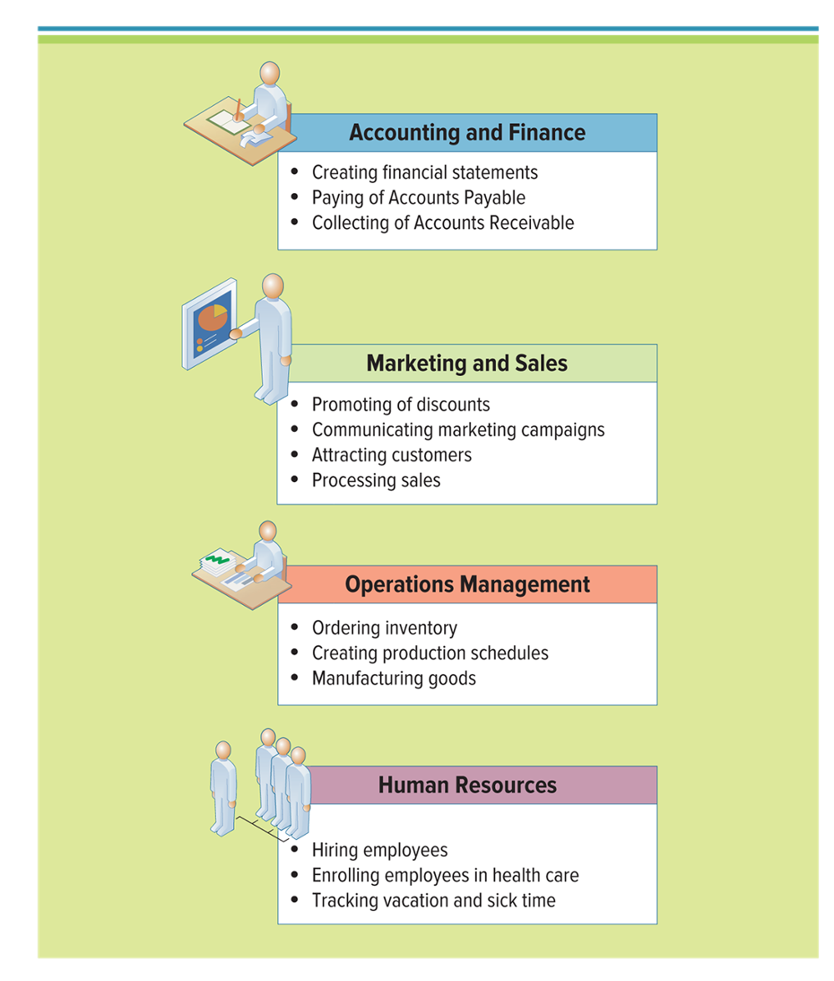
Figure 2.21 Sample Business Processes
Businesses gain a competitive edge when they minimize costs and streamline business processes
Jump to long image description
Notes:
CLASSROOM EXERCISE
Reengineering a Process
There is nothing more frustrated than a broken process.
Ask your students to break into groups and discuss examples of broken processes that are currently causing them pain.
The process can be a university process, mail-order process, Internet-order process, return merchandise process, etc.
Ask your students to agree on one of the broken processes and to reengineer the process.
Students should diagram the “As-Is” process and then diagram their “To-Be” process.
Bring in a large roll of brown package wrapping paper and masking tape. Give each group two large pieces of the paper and ask them to tape the paper to the wall. These make for great “As-Is” and “To-Be” process maps.

Slide 48
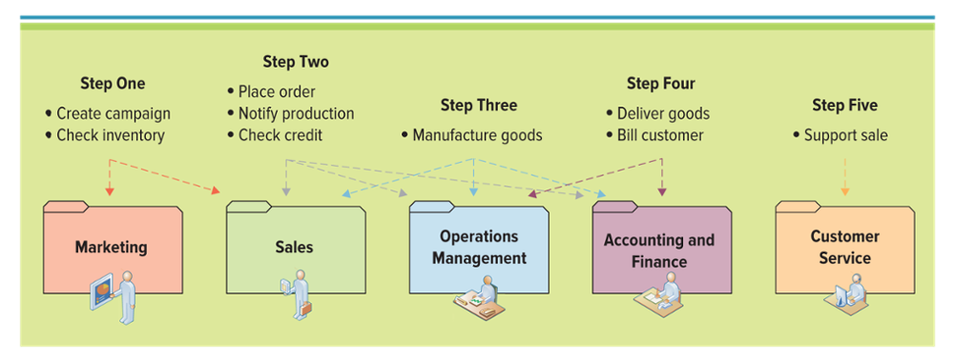
Figure 2.22 Five Steps in the Order-to-Delivery Business Process
Jump to long image description

Slide 49
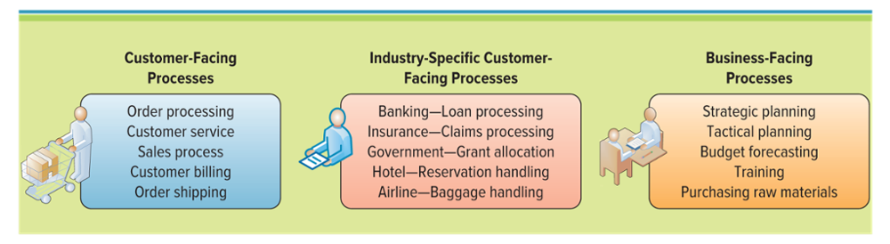
Figure 2.23 Customer-Facing, Industry-Specific, and Business-Facing Processes
Customer facing process - Results in a product or service that is received by an organization’s external customer
Business facing process - Invisible to the external customer but essential to the effective management of the business
Grand important
Notes:
Can you name a few customer facing processes?
Marketing campaign
Sales initiative such as a discount
New product
New service
Distribution of a product or service
Customer billing
Customer service
Order processing
Can you name a few business facing processes?
Goal setting
Day-to-day planning
Performance feedback
Employee rewards
Resource allocation
Strategic planning
Internal budgets
Internal training
Purchasing raw materials in the supply chain

Slide 50


Figure 2.24 BPMN Notation 1 of 2
Symbol | Description
Event | BPMN event is anything that happens during the course of a business process. An event is represented by a circle in a business process model. In Figure 2.25, the events include customer requests, time requests, or the end of the process.
Activity | BPMN activity is a task in a business process. An activity is any work that is being performed in a process. An activity is represented by a rounded-corner rectangle in a business process model. In Figure 2.25, the activities include checking availability, picking up the customers, and confirming the booking
Jump to long image description
Notes:
Business Process Model and Notation (BPMN) is a graphical notation that depicts the steps in a business process.
BPMN provides businesses with a graphical view of the end-to-end flow of their business processes.
Diagramming business processes allows for easy communication and understanding of how core business processes are helping or hindering the business.
Ask your students to identify each type of the BPMN notations
What would be a BPMN event?
What would be a BPMN activity?
What would be a BPMN gateway?
What would be a BPMN flow?

Slide 51


Figure 2.24 BPMN Notation 2 of 2
Symbol | Description
Gateway | BPMN gateway is used to control the flow of a process. Gateways handle the forking, merging, and joining of paths within a process. Gateways are represented by a diamond shape in a business process model. In Figure 2.25, the gateways include determining availability status or accepting/declining the request.
Flow | BPMN flows display the path in which the process flows. Flows are represented by arrows in a business process model. In Figure 2.25, the arrows show the path the customer takes through the taxi cab booking process.
Jump to long image description

Slide 52
Business Process Modeling
Business process modeling (or mapping) - The activity of creating a detailed flow chart or process map of a work process showing its inputs, tasks, and activities, in a structured sequence
Business process model - A graphic description of a process, showing the sequence of process tasks, which is developed for a specific
As-Is process model
To-Be process model
Notes:
Why is it important to diagram the As-Is process prior to diagramming the To-Be process?
It is important to understand the entire process from end-to-end before determining how to fix the process
What is the difference between the As-Is and To-Be process?
As-Is process model: represents the current state of the operation that has been mapped, without any specific improvements or changes to existing processes
To-Be process model: shows the results of applying change improvement opportunities to the current (As-Is) process model

Slide 53
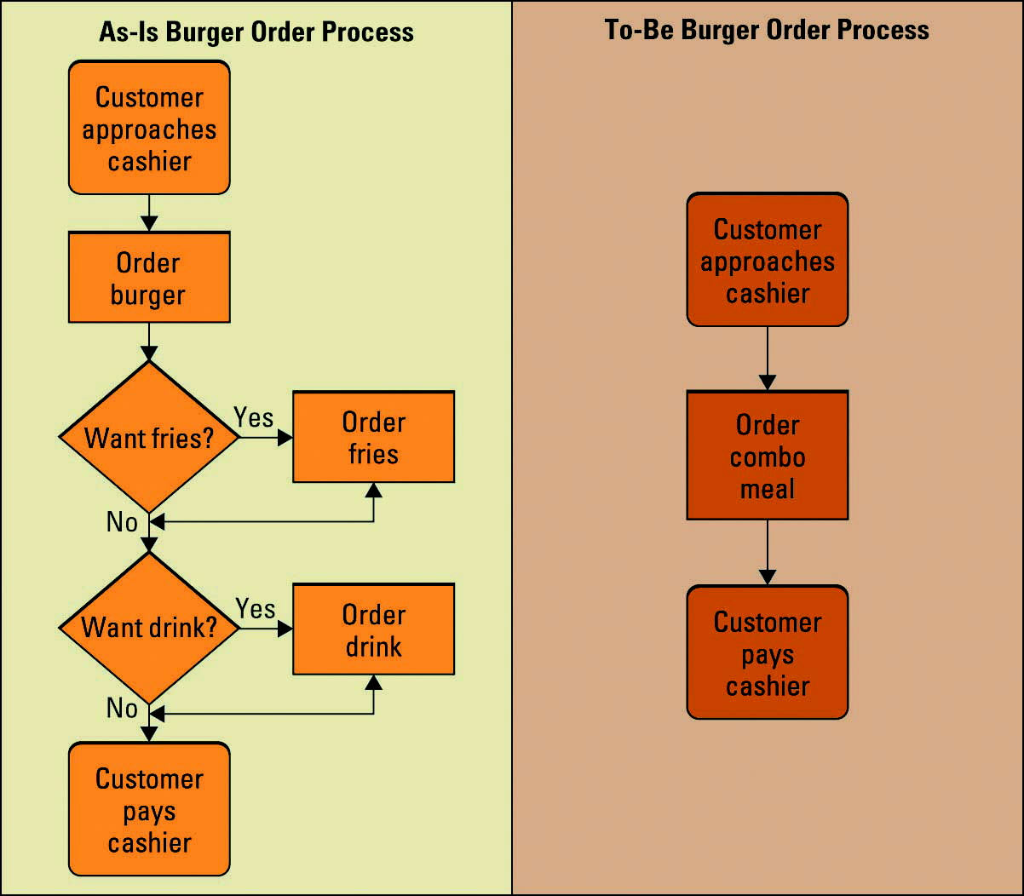
Figure 2.26 As-Is and To-Be Process Model for Ordering a Hamburger
Jump to long image description.
Notes:
Ask your students if they can think of any other processes that have been reengineered
Pumping gas (pay at the pump)
Auto checkout at the grocery store
Bar codes

Slide 54
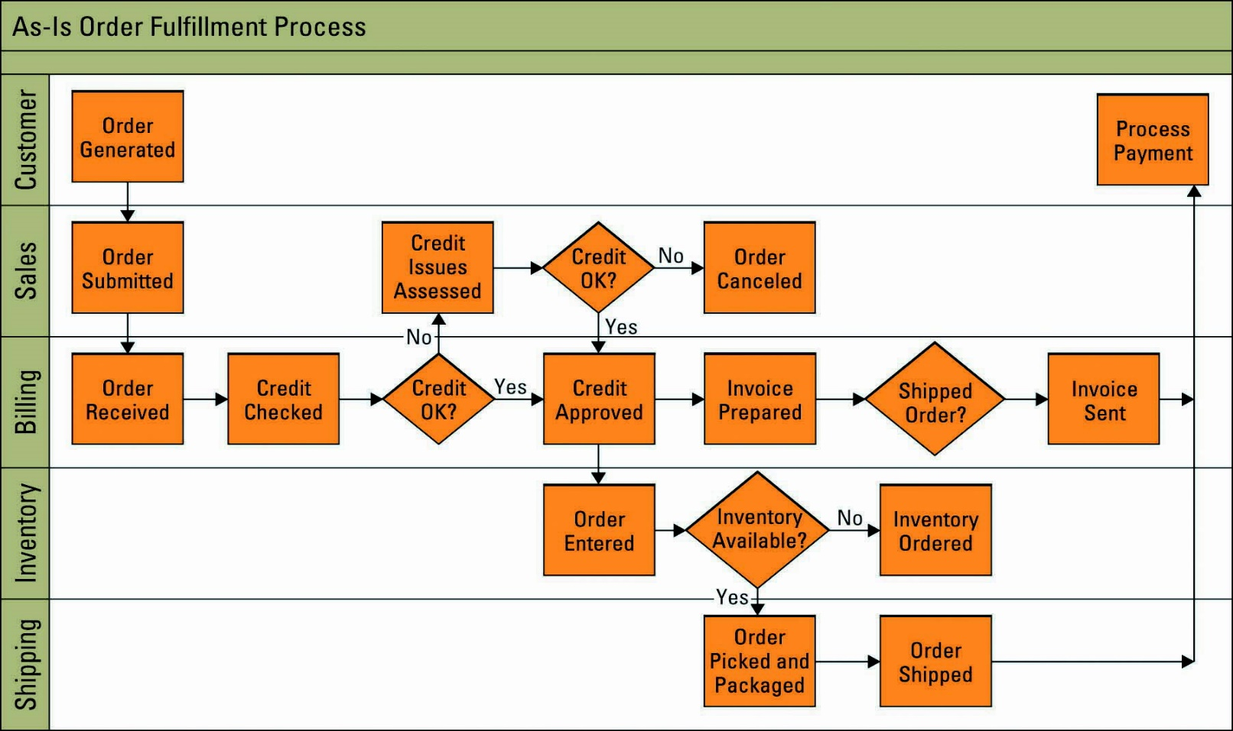
Figure 2.27 As-Is Process Model for Order Fulfillment
Jump to long image description
Notes:
What are the issues with the current As-Is process model?

Slide 55
Using MIS to Improve Business Processes
Workflow – Includes the tasks, activities, and responsibilities required to execute each step in a business process
When you understand how work flows through an organization you can identify bottlenecks, redundancies, and process issues
Notes:
Ask your students why evaluating workflows can help an organization gain efficiencies and effectiveness?
When you understand how work flows through an organization you can identify bottlenecks, redundancies, and process issues
Ask your students to identify workflows they currently encounter along with issues in the workflow
Registering for classes
Paying tuition
Paying rent, utilities, car payments
Registering an insurance claim

Slide 56
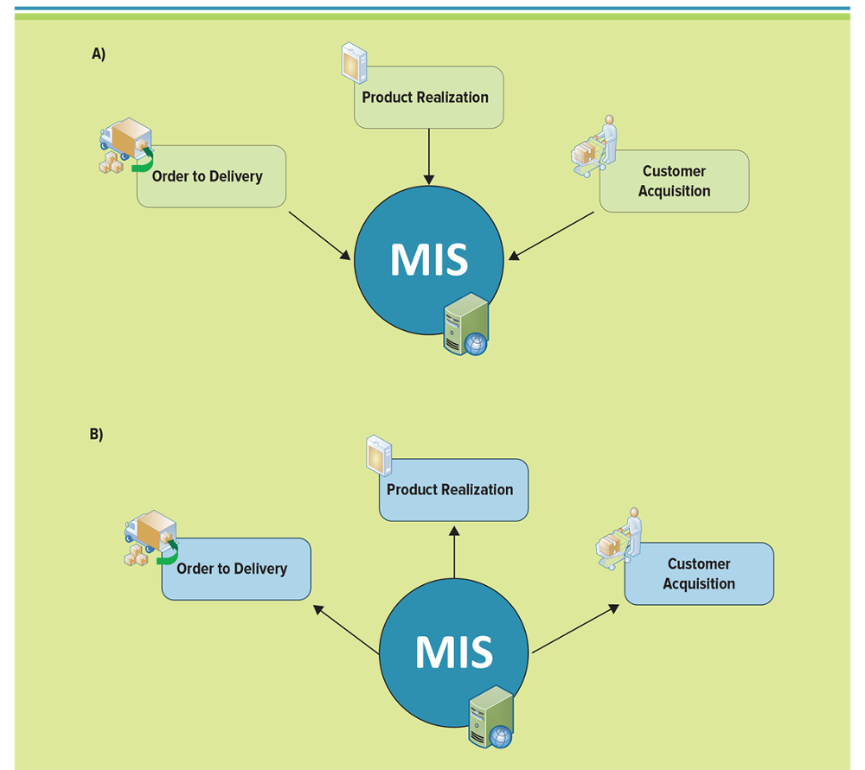
Figure 2.28 For Best Results, Business Processes Should Drive MIS Choices
Jump to long image description

Slide 57
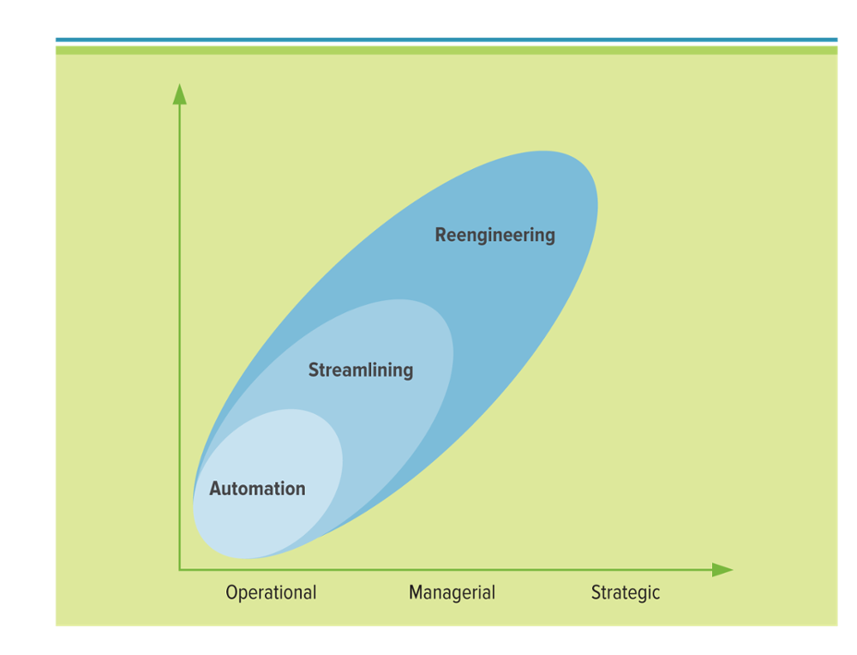
Figure 2.29 Primary Types of Business Process Change
Types of change an organization can achieve, along with the magnitudes of change and the potential business benefit
Jump to long image description
Notes:
A true BPR effort does more for a company than simply improve it by performing a process better, faster, and cheaper
Progressive Insurance’s BPR effort redefined best practices for its entire industry
The figure displays the different types of change an organization can achieve, along with the magnitude of change and the potential business benefit
What is an example of each type of change on the change spectrum?
Automate: answering phones with computers, auto grading an essay or Excel project
Streamline: remove duplicate jobs in the process, use a different tool to perform the same task
Reengineering: taking an airplane instead of a bike, horse, or car, taking BPR to the level where you redefine an entire industry, such as Progressive Insurance

Slide 58
Operational Business Processes – Automation 1 of 2
Operational business processes - Static, routine, daily business processes such as stocking inventory, checking out customers, or daily opening and closing processes
Operationalized analytics - Makes analytics part of a business process
By incorporating analytics right into the business process you can ensure that the company is gathering constant data on the business process allowing it to automatically monitor and measure how the business process is performing. Helping with efficiency and effectiveness, remember if you can’t measure it you can’t manage it!
Notes:
What does operationalized analytics do for a company?
By incorporating analytics right into the business process you can ensure that the company is gathering constant data on the business process allowing it to automatically monitor and measure how the business process is performing. Helping with efficiency and effectiveness, remember if you can’t measure it you can’t manage it!

Slide 59
Operational Business Processes – Automation 2 of 2
Customers are demanding better products and services
Business process improvement – Attempts to understand and measure the current process and make performance improvements accordingly
Automation – The process of computerizing manual tasks
Notes:
Can you name any other types of recent business process improvement examples?
Eliminate redundancies
Improve efficiency
Improve effectiveness
Streamline processes
Make your business better, faster, cheaper!
A great example of automation is the online checking for air travel

Slide 60
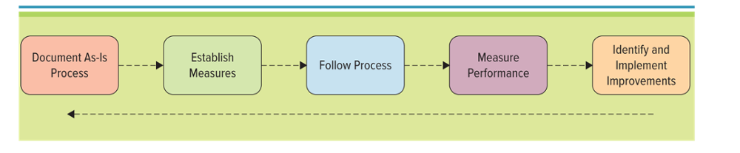
Figure 2.31 Steps in Business Process Improvement
Notes:
Can you name an organization, product, or service that does not require any improvement?
This would be a perfect organization which does not exist
Is continuous process improvement a one-time event?
No, it is continuous

Slide 61
Managerial Business Process Streamlining
Streamlining – Improves business process efficiencies by simplifying or eliminating unnecessary steps
Bottleneck – Occur when resources reach full capacity and cannot handle any additional demands
Redundancy – Occurs when a task or activity is unnecessarily repeated
Notes:
Ask your students to provide an example of each streamlining, bottleneck, and redundancy
Streamlining: Automatically sending an email to a customer informing them that the product has shipped
Bottleneck: So many new orders for a discounted product that the warehouse doesn’t have enough staff to gather, box, and ship the orders within the 24 hour promised timeframe
Redundancy: Having the picker, warehouse manager, and shipping department employee check the order invoice against what is actually in the box

Slide 62
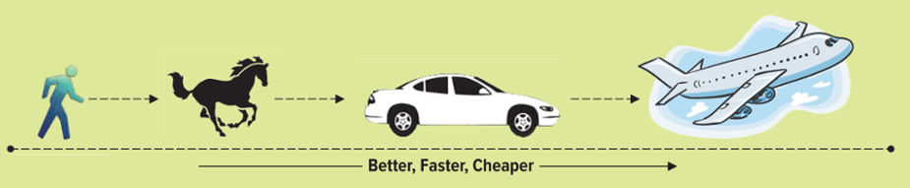
Figure 2.32 Different Ways to Travel the Same Route
A company can improve the way it travels the road by moving from foot to horse and then horse to car
BPR looks at taking a different path, such as an airplane which ignores the road completely
Notes:
Companies frequently strive to improve their business processes by performing tasks faster, cheaper, and better
The above figure displays different ways to travel the same road
A company could improve the way that it travels the road by moving from foot to horse and then from horse to car
However, true BPR would look at taking a different path. A company could forget about traveling on the same old road and use an airplane to get to its final destination. Companies often follow the same indirect path for doing business, not realizing there might be a different, faster, and more direct way of doing business.

Slide 63
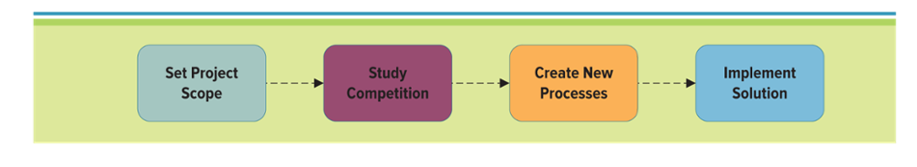
Figure 2.33 Business Process Reengineering Model
Business process reengineering (BPR) - Analysis and redesign of workflow within and between enterprises
Notes:
What is the difference between continuous process improvement and business process reengineering?
BPR relies on a different school of thought than continuous process improvement
In the extreme, BPR assumes the current process is irrelevant, does not work, or is broken and must be overhauled from scratch
Such a clean slate enables business process designers to disassociate themselves from today’s process and focus on a new process
It is like the designers projecting themselves into the future and asking: What should the process look like? What do customers want it to look like? What do other employees want it to look like? How do best-in-class companies do it? How can new technology facilitate the process?
BPR reached its heyday in the early 1990s when Michael Hammer and James Champy published their best-selling book, Reengineering the Corporation.
The authors promoted the idea that radical redesign and reorganization of an enterprise (wiping the slate clean) sometimes was necessary to lower costs and increase quality of service and that information technology was the key enabler for that radical change.
Hammer and Champy believed that the workflow design in most large corporations was based on invalid assumptions about technology, people, and organizational goals. They suggested seven principles of reengineering to streamline the work process and thereby achieve significant improvement in quality, time management, and cost.

Slide 64
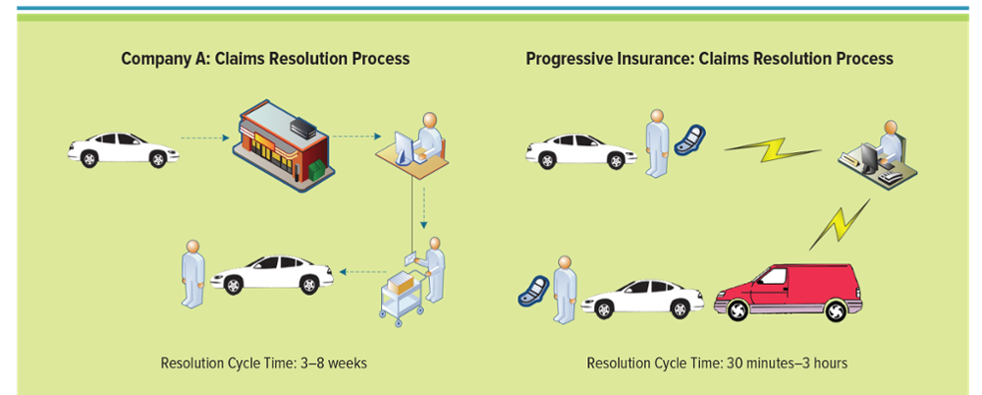
Figure 2.34 Auto Insurance Claims Processes
Radical and fundamentally new business processes enabled Progressive Insurance to slash the claims settlement from 31 days to four hours. The customer gets into an accident, has the car towed, and finds a ride home. The customer then calls the insurance company to begin the claims process, which usually takes over a month.
Progressive Insurance improved service to its customers by offering a mobile claims process. When a customer has a car accident he or she calls in the claim on the spot. The Progressive claims adjustor comes to the accident and performs a mobile claims process, surveying the scene and taking digital photographs. The adjustor then offers the customer on-site payment, towing services, and a ride home.
Jump to long image description
Notes:
Radical and fundamentally new business processes enabled Progressive Insurance to slash the claims settlement from 31 days to four hours. Typically, car insurance companies follow this standard claims resolution process: The customer gets into an accident, has the car towed, and finds a ride home. The customer then calls the insurance company to begin the claims process, which usually takes over a month (see Figure).
Progressive Insurance improved service to its customers by offering a mobile claims process. When a customer has a car accident he or she calls in the claim on the spot. The Progressive claims adjustor comes to the accident and performs a mobile claims process, surveying the scene and taking digital photographs. The adjustor then offers the customer on-site payment, towing services, and a ride home. (see Figure).

Slide 65
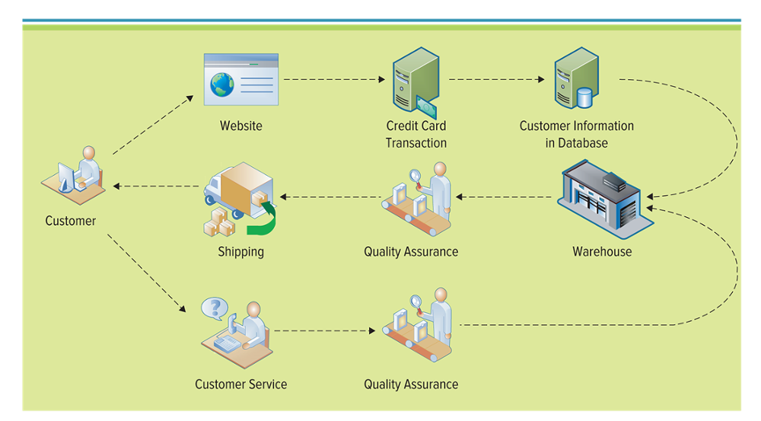
Figure 2.35 Online Sales Process Model
Examining And Reengineering A College Business Process
Jump to long image description
Notes:
Organizations are only as effective as their business processes
Developing logical business processes can help an organization achieve its goals
CLASSROOM EXERCISE
Examining And Reengineering A College Business Process
Ask your students to discuss issues they have encountered around the college due to an inefficient or ineffective process.
Choose one of the processes, break your students into groups, and ask them to reengineer the process.
How would they change it to make it more effective or more efficient?
Would they add a new technology device to help with the process such as a scanner, PDA, or RFID?
Be sure to have them diagram the As-Is process and the To-Be process. Have them present their reengineered processes to the class.

Slide 66
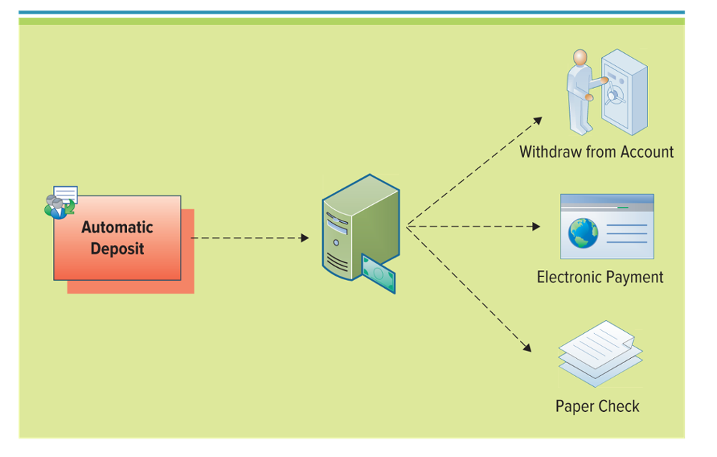
Figure 2.36 Online Banking Process Model
Notes:
This diagram displays the process of an online banking process model
Ask your students to diagram an example of a customer placing an order at Amazon

Slide 67
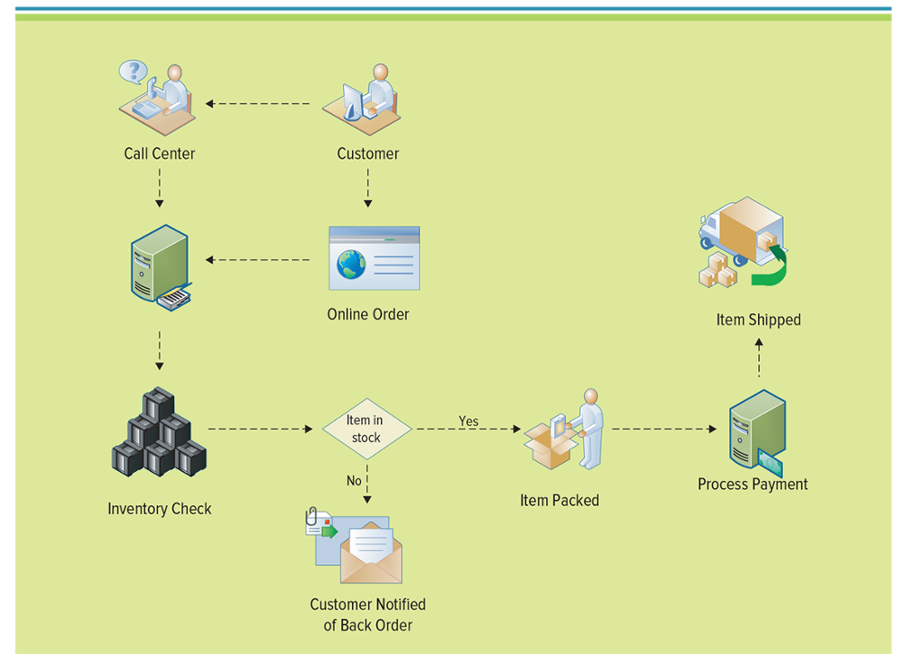
Figure 2.37 Order Fulfillment Process Model
Jump to long image description.
Notes:
Potential order fulfillment process model such as Amazon.com might use

Slide 68
Learning Outcome Review
Now that you have finished the chapter please review the learning outcomes in your text.

